Slide 1
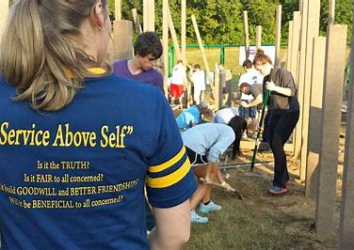
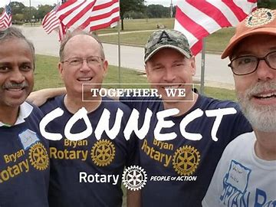
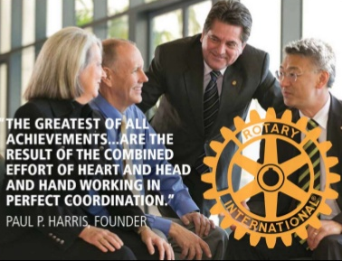

What is Rotary about?
“Service Above Self”
1.2 million Rotarians – 35,000 Clubs – 200 Countries
Plus clubs for teenagers and young adults
Notes:
Rotary is a membership organization that does service. We are a global network of business and professional leaders. We do humanitarian service projects and encourage high ethical standards. We strive for goodwill and peace in the world. There are 1.2 million of us in 35,000 clubs in over 200 countries around the world. Our motto is Service Above Self.

Slide 2


$200 Million and 16 Million
Volunteer Hours
Rotarians invest more than $200 million and 16 million volunteer hours every year.
Notes:
Rotarians are people of action because we are guided by a strong vision. Together, we see a world where people unite and take action to create lasting change – across the globe, in our communities, and in ourselves. Each year, Rotarians invest more than $200 million and 16 million volunteer hours to promote peace, fight disease, provide clean water, save mothers and children, support education and grow local economies.

Slide 3
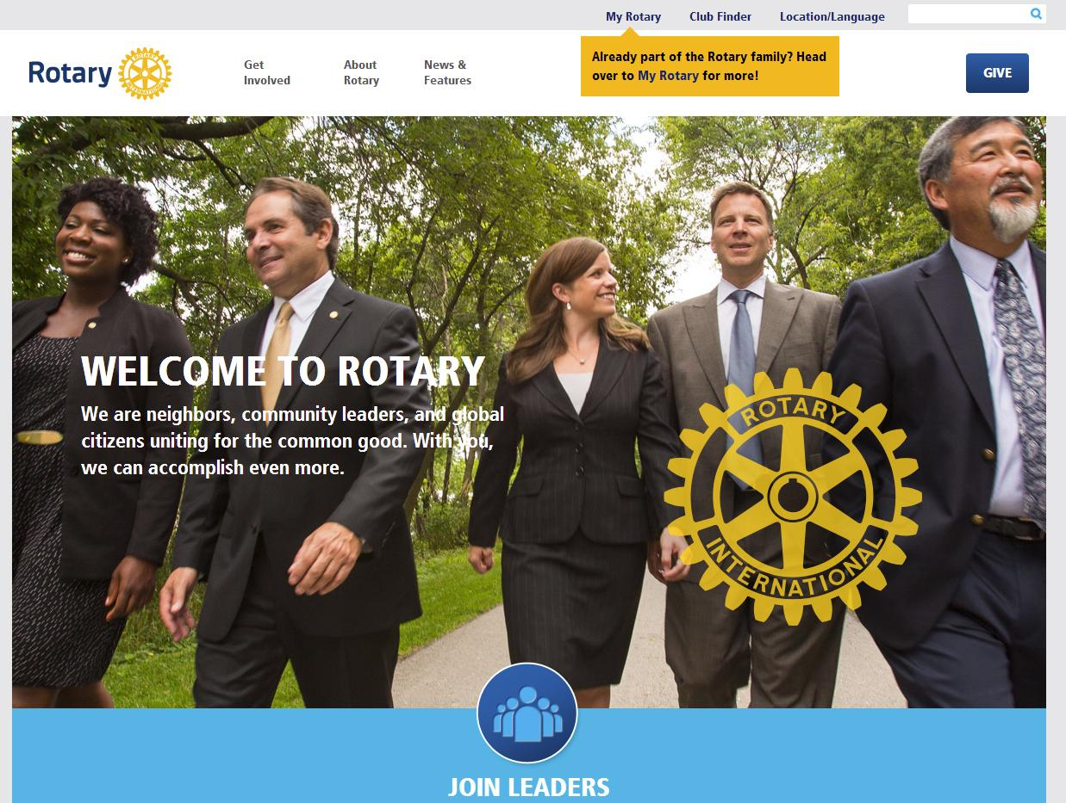

Neighbors, friends, and problem solvers share ideas and take action to create lasting change.
Notes:
Put simply, Rotary is where neighbors, friends, and problem solvers share ideas and take action to create lasting change. It can be a life-changing experience because of the extraordinary people you will meet. Rotarians who will be a mentor and role model for you and who will help you build your business network.

Slide 4
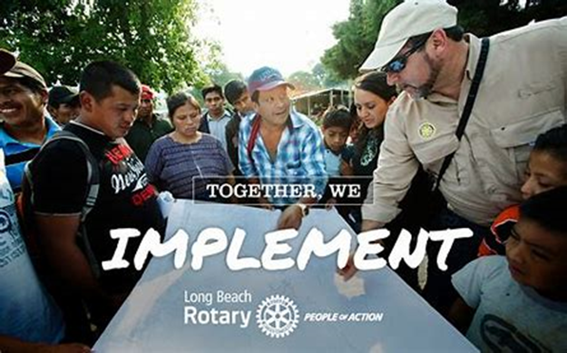




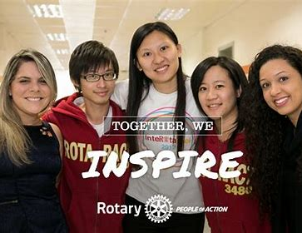
People Of Action
Notes:
To answer the question what is Rotary… We are the largest most financially sound membership organization whose logo is recognized in more countries than any other in the world. Every minute of every day we feed, we house, we vaccinate, educate, advocate, comfort and provide services. This is Rotary!

Slide 5
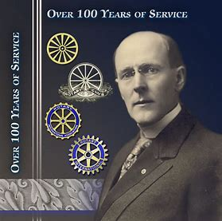
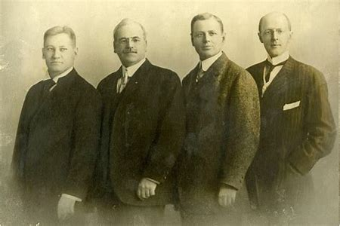
Our History
From left: Gustavus Loehr, Silvester Schiele, Hiram Shorey and Paul Harris.
Paul Harris
The first Rotary Club was organized in 1905, by Chicago Attorney Paul Harris. The original four-member club met for fellowship in rotation at member’s offices…
thus the name ROTARY and the foundation on which we are built.
Notes:
Great history in how Rotary got started. Paul Harris an attorney in Chicago gathered some friends in 1905 for fellowship and it grew from there. Their first reason for being was FELLOWSHIP. Meetings were rotated from office to office and that’s how Rotary got its name.

Slide 6


Rotary International President
The President of Rotary International is the highest-ranking Rotary officer and chairs the Rotary Board of Directors. He/she is the first representative of Rotary to Heads of State, the media and the public.
Read the latest newsletter from Rotary International to stay up to date with messaging, events, and happenings in Rotary
https://www.rotary.org/en/news-features
https://www.rotary.org/en/rotary-magazine

Slide 7

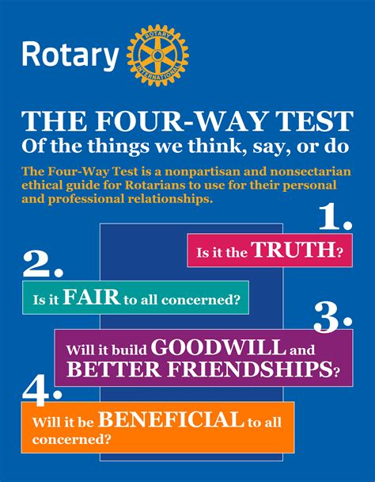
Core Values & Four-Way Test
Notes:
The Four Way Test is used by Rotarians world-wide as a moral code for personal and business relationships. It can be applied to almost any aspect of life by asking four simple questions…Is it the truth, is it fair to all concerned, will it build good will and better friendships, will it be beneficial to all concerned. Now some Rotarians have added a 5th question, is it fun? Because while we work hard on our projects, we also like to have fun. The four way test goes hand in hand with Rotary’s Core Values. The world today is very different than it was when Rotary was founded in 1905. But what hasn’t changed are our core values of fellowship, integrity, diversity, service and leadership. You can see on the screen I came across a song about the Four Way Test and if we had time we’d have Terry Weaver sing it for us. But since we are pressed for time, we’ll let him off the hook.

Slide 8
The Object of Rotary
To promote the idea that service is valuable and to encourage and foster:
The opportunity to build friendships while serving your community
High ethical standards in business, the value of different occupations and the use of each Rotarian’s professional skills in giving back
Incorporating service into every aspect of a Rotarian’s life – personal, business and community.
Increased cultural understanding, goodwill and peace around through a unified goal of community service.
Notes:
The Four Way Test is used by Rotarians world-wide as a moral code for personal and business relationships. It can be applied to almost any aspect of life by asking four simple questions…Is it the truth, is it fair to all concerned, will it build good will and better friendships, will it be beneficial to all concerned. Now some Rotarians have added a 5th question, is it fun? Because while we work hard on our projects, we also like to have fun. The four way test goes hand in hand with Rotary’s Core Values. The world today is very different than it was when Rotary was founded in 1905. But what hasn’t changed are our core values of fellowship, integrity, diversity, service and leadership. You can see on the screen I came across a song about the Four Way Test and if we had time we’d have Terry Weaver sing it for us. But since we are pressed for time, we’ll let him off the hook.

Slide 9
We think differently:
Every member has unique experiences, abilities, and expertise to shape how we solve problems.
We transform Communities
to make a lasting difference.
We transform ourselves
as leaders, humanitarians, and global citizens.
We have fun!
because it strengthens relationships, sustains engagement, and reinforces the core spirit of Service Above Self.
Notes:
The Four Way Test is used by Rotarians world-wide as a moral code for personal and business relationships. It can be applied to almost any aspect of life by asking four simple questions…Is it the truth, is it fair to all concerned, will it build good will and better friendships, will it be beneficial to all concerned. Now some Rotarians have added a 5th question, is it fun? Because while we work hard on our projects, we also like to have fun. The four way test goes hand in hand with Rotary’s Core Values. The world today is very different than it was when Rotary was founded in 1905. But what hasn’t changed are our core values of fellowship, integrity, diversity, service and leadership. You can see on the screen I came across a song about the Four Way Test and if we had time we’d have Terry Weaver sing it for us. But since we are pressed for time, we’ll let him off the hook.

Slide 10
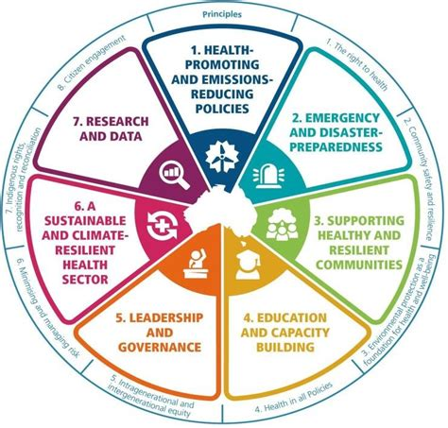
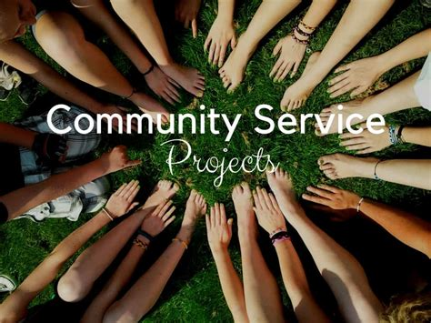
Seven Areas Of Focus
These areas reflect critical humanitarian issues and needs that Rotarians are addressing worldwide.
Notes:
Seven Areas of Focus help us build international relationships, improve lives, create a better world, support peace and end polio forever. All critical humanitarian issues Rotarians have been working on for many years.

Slide 11

Go further, learn more..
with MyRotary.org account:
Sign in or register to access your
My Rotary portal
where you can find resources, reports, learning materials, and more for your club and role
email data@rotary.org for your Rotary ID or any questions about your account.
Call Rotary.org Support at 866-976-8279
Go to Learn.Rotary.org
Begin by searching on Rotary Basics

Slide 12


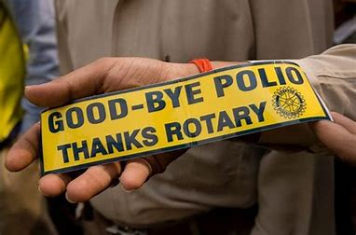

The Rotary Foundation: $4 billion spent on life-changing projects
When you give to The Rotary Foundation, you fuel our service projects - those that eradicate polio, promote peace, and improve developing communities.
DONATE
99.9% Reduction Of Cases Worldwide
Notes:
Rotary has a non-profit foundation that promotes world understanding and peace. Since it was founded more than 100 years ago, the Foundation has spent more than $4 billion on life-changing, sustainable project from preventing disease to providing clean water, supporting education, growing local economies, saving mothers and children and promoting peace.

Slide 13

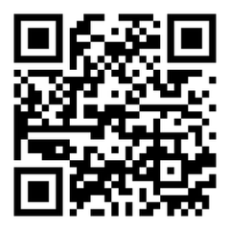
Colorado Rotary focuses on many causes and projects being completed in our district!
To name a few: EPIC Day of Service, Wildfire Ready, Youth Leadership camps, WASH - Water, Sanitation, and Hygiene, Pediatric Mental Health.
Stay up to date with events, news, recordings, resources, and club listings on our District Website
https://rotary5450.org
External introduction to: www.coloradorotary.org
Notes:
The Rotary Club of Forest Acres is one of 74 clubs in District 7770 that includes 25 counties in eastern South Carolina. Our 2021-22 District Governor is Paul Walter, a member of the Rotary Club of Hilton Head Island but he originally joined Rotary in Spartanburg in 2001. Our Forest Acres Club used to be known as a small club with a big heart but so many people have joined the club over recent years, we are now a medium size club with an even bigger heart as we give approximately $30,000 annually to non-profit community service organizations. We’re known best for the Forest Acres Festival which we have co-sponsored with the City of Forest Acres for over 20 years.

Slide 14
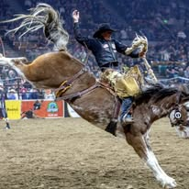
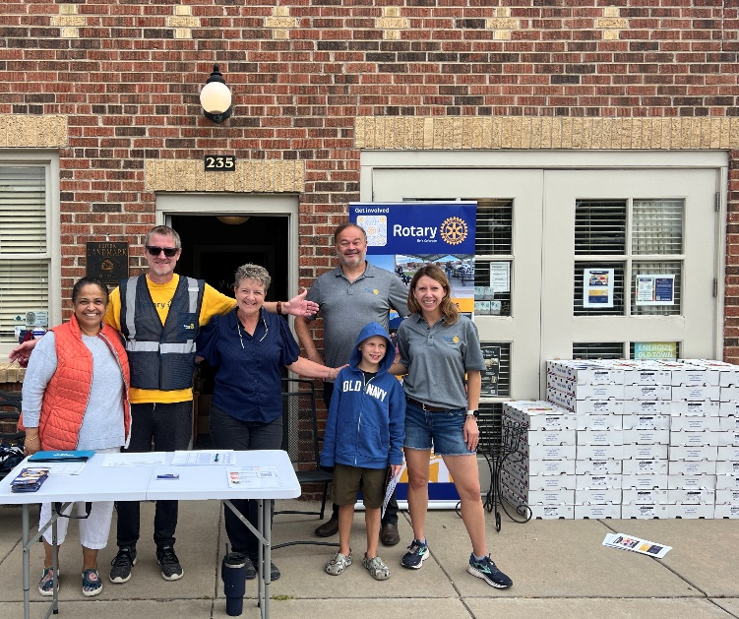
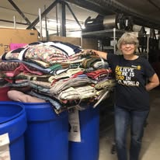
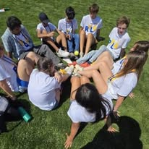
Rotary District 5450
Encompasses Members from Castle Rock to Northern Colorado to the Eastern Plains to Summit County in the Mountains
Notes:
Welcome to Discover Rotary. Let’s begin by having everyone do a brief 30 second introduction to include name, vocation and for club members what attracted you to Rotary and what’s kept you coming back and for our potential members, what sparked your interest in Rotary. I am Sandy Olson of the Rotary Club of Forest Acres. My encore career includes teaching life-long learning classes, mentoring and training Rotarians on intentional membership growth strategies. I joined Rotary for friends and fellowship and that kept me coming back for 19 years.

Slide 15


District governors provide leadership, motivation, and guidance to Rotary clubs. Governors act as officers of RI, fostering achievement in their district at the club level.
2026-2027 District Governor Nominee Cindy Chase Cindy joined Denver Cherry Creek Rotary in 2017.
Read the latest newsletter from our current District Governor to stay up to date with district messaging, events, and happenings in Rotary
https://rotary5450.org/bulletins/2026/
Notes:
The Rotary Club of Forest Acres is one of 74 clubs in District 7770 that includes 25 counties in eastern South Carolina. Our 2021-22 District Governor is Paul Walter, a member of the Rotary Club of Hilton Head Island but he originally joined Rotary in Spartanburg in 2001. Our Forest Acres Club used to be known as a small club with a big heart but so many people have joined the club over recent years, we are now a medium size club with an even bigger heart as we give approximately $30,000 annually to non-profit community service organizations. We’re known best for the Forest Acres Festival which we have co-sponsored with the City of Forest Acres for over 20 years.

Slide 16
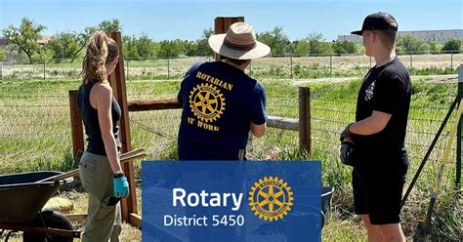
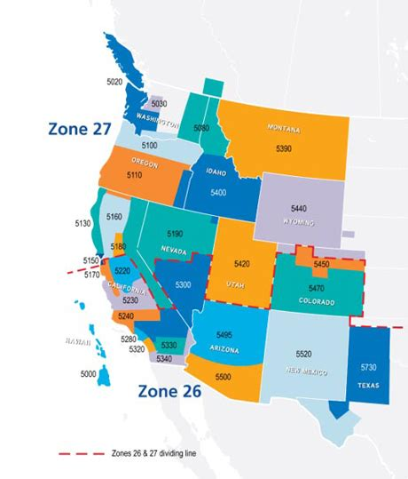
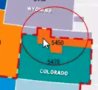
Leverage Resources
Districts connect clubs with each other and to resources from Rotary International.
www.5450rotary.org
News, events, training & recordings
D5450 Rotary 101: (District Structure, Grants, Youth Programs, and more)
RISE Leadership Training: Proven leadership concepts focused on serving others
Membership Huddles: A lively gathering and opportunity to learn, share, and collaborate on membership topics.
District
Zones provide administration and support to districts.
Expert Hub
zone2627.org/experthub/
Resources
zone2627.org/resources/
Zone

Slide 17
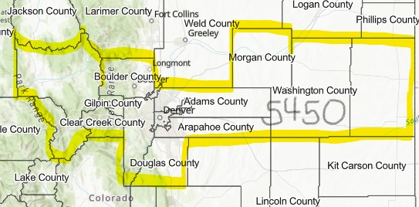

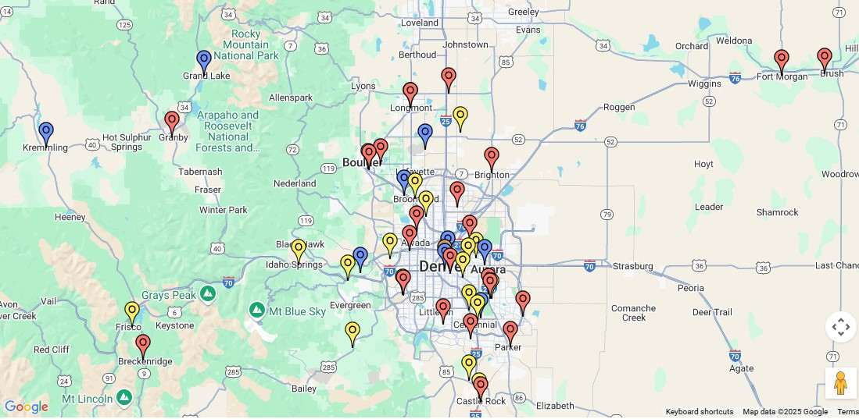
D5450 maps
Lots of room to experience Rotary and grow!
Over 2400 (July 2026) members strong and growing!

Slide 18
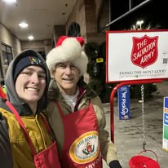
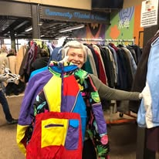
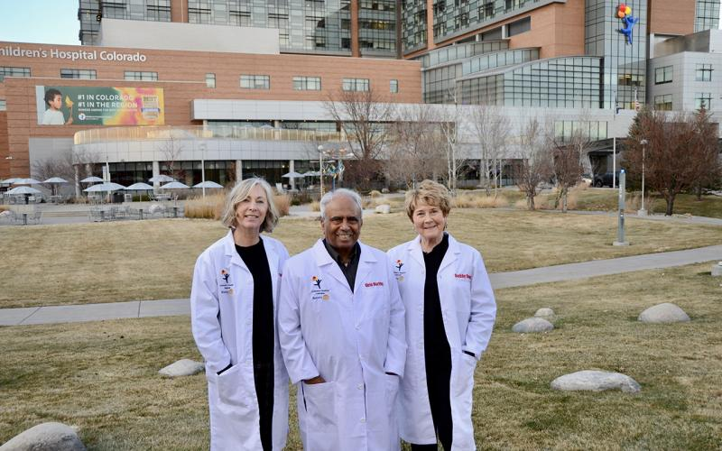
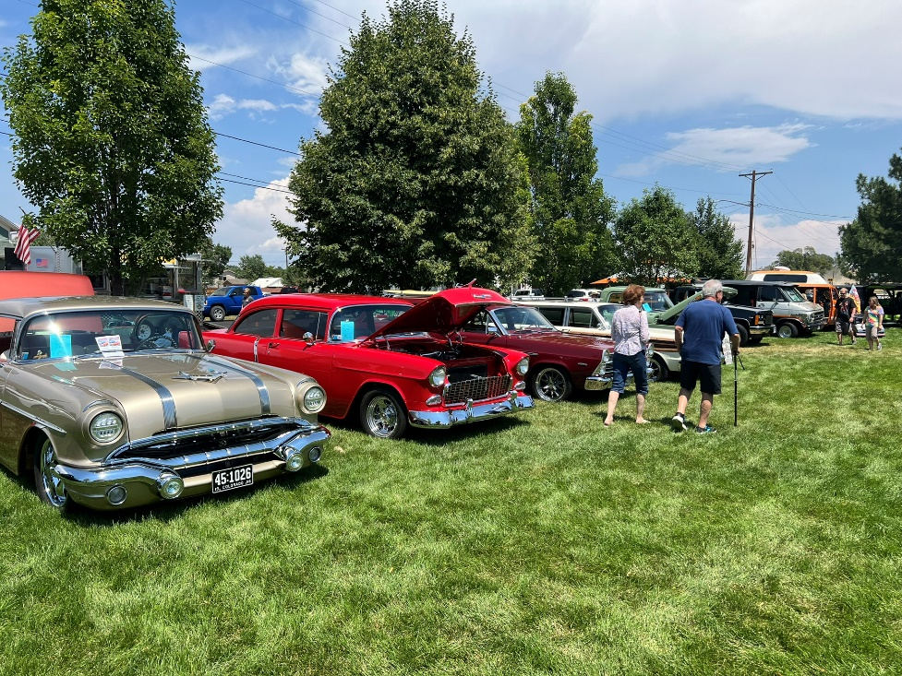
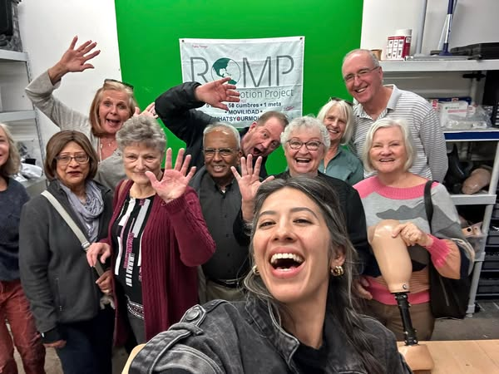
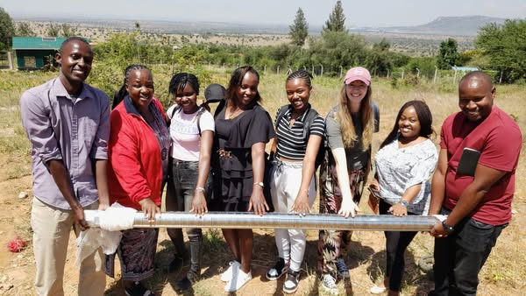

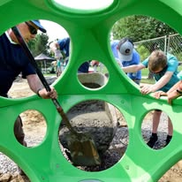
Project Highlights
Notes:
A new project for our club this year was a coat drive held during the month of October. It involved 100% of our club members and we successfully collected 300 hundred coats and distributed them to 10 different community service organizations.

Slide 19
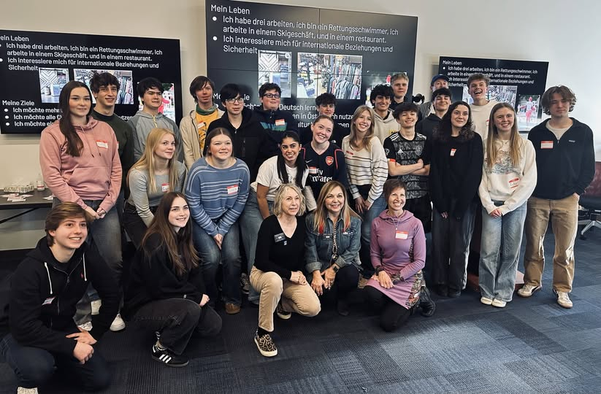
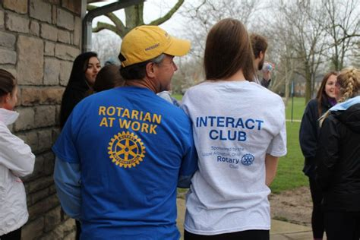
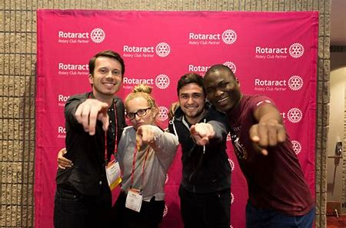
Youth Leadership
Rotary Exchange Program
Rotary Youth Leadership Academy
Notes:
Rotarians believe in developing the next generation of leaders. Our programs help young people build leadership skills, expand education and learn the value of service. They may join Interact Clubs for those age 12-18 and Rotaract Clubs now available for anyone 18 and older. There are a number of grants and scholarships available from Youth Exchange to Rotary Peace Fellowships.

Slide 20
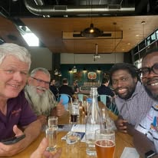
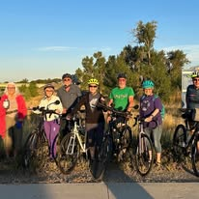
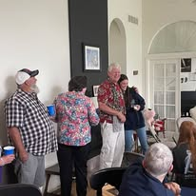
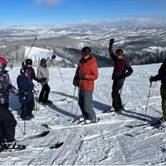
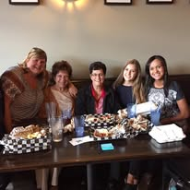
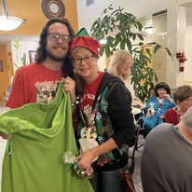
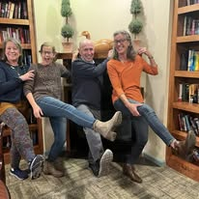
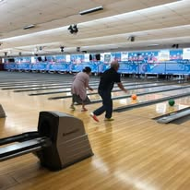
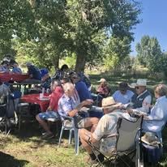
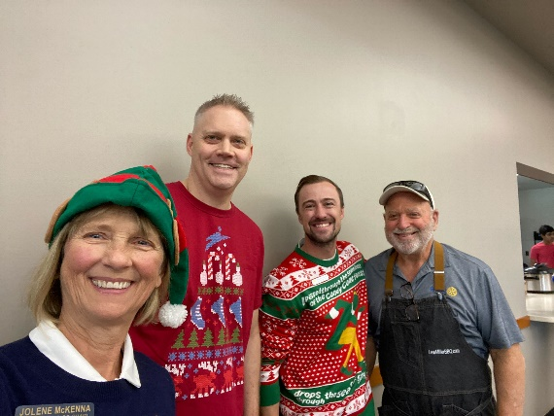
Rotarians Have Fun!
Notes:
We also know how to have fun! From performing as the Blues Brothers and Sisters to Hoola Hoop contests, and a Chorus Line!

Slide 21
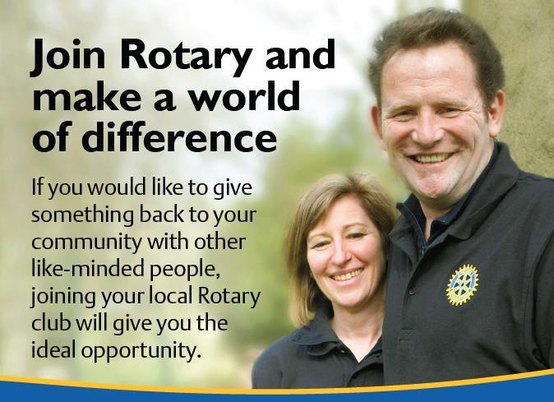
About your Club
Now __ members strong and growing! (be creative)
Notes:
Thanks for your interest in Forest Acres Rotary

Slide 22


Club Membership (make your club irresistible)
Notes:
Forest Acres is now recognized as one of the most vibrant clubs in D-7770. We were recently honored as the 2020-21 Medium Club of the Year in our District. We have fund club meetings and great speakers, and while we work very hard on our projects and fundraisers…

Slide 23
The Rotary Club of [Your Club]
Projects (examples):
Community
Youth Scholarships
Food Banks
Shelter Box
Paint Reclamation
Interact Club
Notes:
We have several service projects throughout the club year from making sure students have new shoes to start school with to fighting hunger and promoting literacy. We raise money through sponsorships of the Forest Acres Festival.

Slide 24

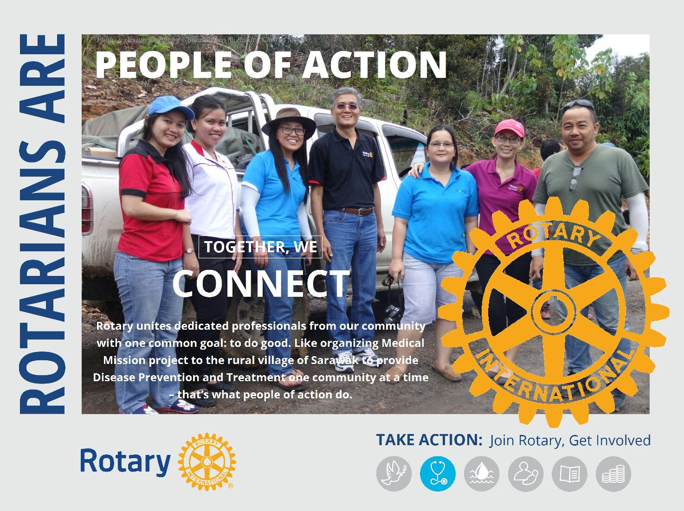
Our Causes and Impact (your clubs focus
“If you have the love of your fellow men in your heart, my friend, you are a potential Rotarian.”
Notes:
Paul Harris said it best when describing what it takes to be a Rotarian when he said, “if you have the love of your fellow men in your heart, my friend, you are a potential Rotarian.”

Slide 25

[Our Club] Annual Dues 2026/2027
Rotary International & District Dues $171.00
Includes Rotary Magazine, Support, and Insurance
Rotary District Dues $60.00
Rotary Foundation Donation (if included) $xx.00
Club Dues $xxx.00
Meals & Facility
Total Dues: $xxx.00
Notes:
It costs $175 quarterly to be a member of Forest Acres Rotary. That covers RI and District Dues as well as a subscription to the Rotary Magazine. It also includes club dues and meal costs since we are a weekly lunch club.

Slide 26
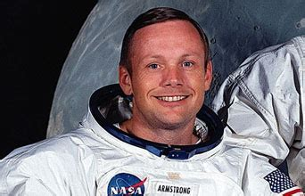
Why do people join?
Just a few of the reasons millions of people joined Rotary, even Neil Armstrong.
Friendship, camaraderie and fun
Give back to community
Be part of something larger than yourself
Professional networking
Leadership training
Personal growth and recognition
Now it is your turn!
Notes:
There are many good reasons to join Rotary. Life-long friends, making the community a better place, being part of something larger than yourself, networking, leadership and personal growth. These are just a few of the reasons why millions of people have joined Rotary over the past 117 year. Yes, Rotary celebrates 117 years of service on Feb 23rd. I’d say we look pretty good to be 117 years old.

Slide 27
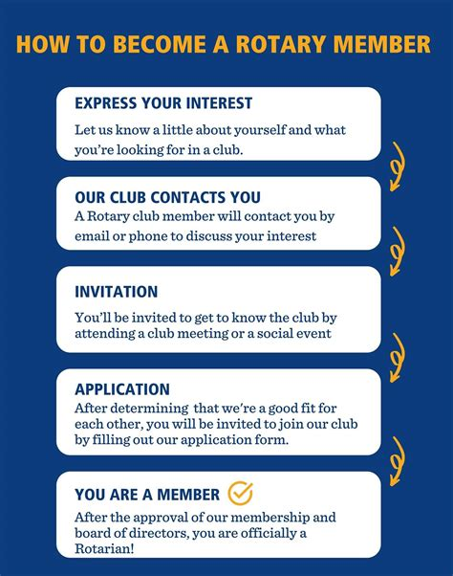
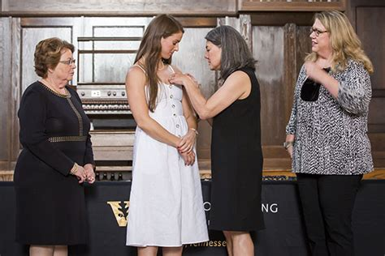
How To Join Rotary
New members become quickly involved in club activities, events, and consider leadership positions.
Add links here for quick access
Notes:
There is a process for joining Forest Acres Rotary. Membership is by invitation from a Rotarian. You submit a completed membership proposal form and when the board of directors approves your membership, you are inducted into the club. You are assigned a new member mentor and attend new member orientation training. But most important of all…you become quickly involved in club activities and events and eventually we encourage all new members to consider a leadership position in the club.

Slide 28

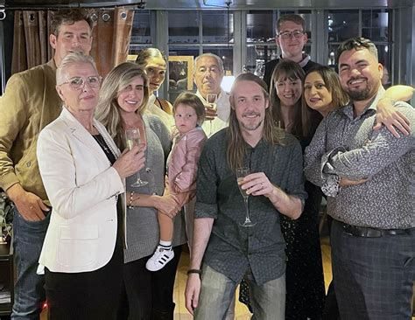
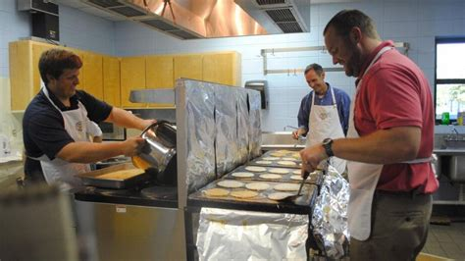





What Could Rotary Bring To You?
By joining Rotary, you gain a friend in every corner of the world." 💙

Slide 29
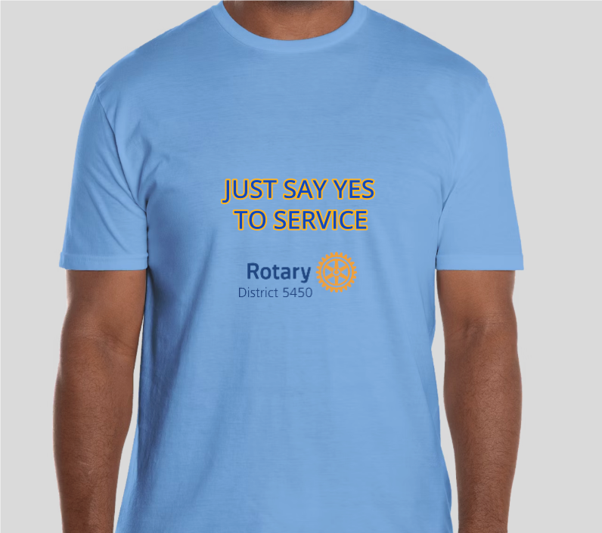



DO WE HAVE FUN?
YES!
What Could You Bring To Rotary?
People give their energy and lend their resources: What matters most to you?" 💙

Slide 30


